Slide 1
DEP P03 R&D Grant Management Portal
Anisha Anshika Asad Shiva

Slide 2
Table of contents
01
Progress
02
Understanding
Week 1 meetings, sessions, progress
The code structure and functionality
03
Improvement
04
Next week
Identify scope of update, improvement
What we plan to do next

Slide 3
Progress
01
Week 1 meetings, sessions, progress

Slide 4
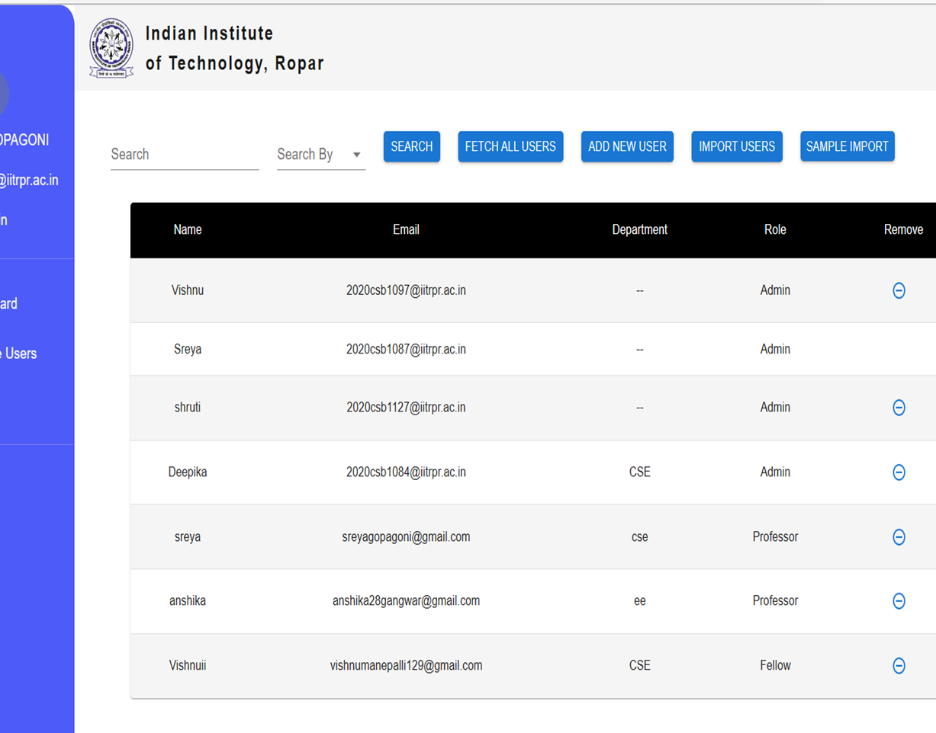
Meetings and Progress
In this week, firstly we collected the code, understood it
In an offline meeting with previous developers, we understood the concepts and logics used behind each functionality.
Set up the environment to run the web application locally
Used every functionality of the web application for better understanding

Slide 5
About the project
Web-Based
Stakeholders
Existing R&D grant application is web-based platform capable of effectively managing grants for Research and Development for IIT Ropar
Research and Development grants management section (Admins)
Faculty (Professors)
Research Fellows

Slide 6



Technologies Used
Frontend
Backend
Deployment
React JS
TypeScript + JavaScript
MUI & TailwindCSS
React-router (client-side routing)
TypeScript
Nest.js
Express.js
Excel JS
Node-pg
PostgreSQL
Google OAuth
Render
Server: Nginx, PM2, PostgreSQL

Slide 7
Understanding
02
The code structure and functionality

Slide 8
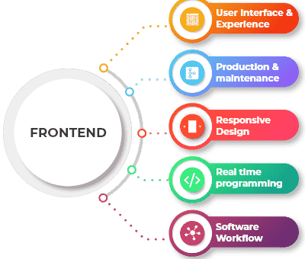
Frontend Code Structure
node modules
frontend
public
src
package.json
package-lock.json

Slide 9
Frontend Code Structure
components
editFellow
editSanctioned
getUser
getComment
listofProjects
InsertMainTable
getmainTable
showProject
updatedAddfund
getMarkread
specificProject
updateStatus
getProjectcolor
specificUser
upload_users_file
getSummaryComment
ToActual
editSanctioned
userEXIST
userType

Slide 10

Backend Code Structure
node modules
backend
index.js
backendqueries.sql
package.json
package-lock.json
node modules

Slide 11
Backend Code Structure
components
addComment
createProject
addFund
db
addFellow
delFellow
addSummaryComment
delProject
addUser
delrow
apprProject
delUser

Slide 12
Improvement
03
Identify scope of update, improvement

Slide 13

Introduction of New Import and Request Feature
Simplifying Project Request Process
Easy Submission of Multiple Project Requests
Introducing Import Button for Excel Sheet Input
Streamlining Procedure for Professors
Enhancing Efficiency in Project Management

Slide 14
Integration of Help Section
User Support
Enhancing User support with Help Section
Seamless Navigation
Providing useful links for Improved accessibility
Better Utility
Offering guidance for seamless access and utilization

Slide 15
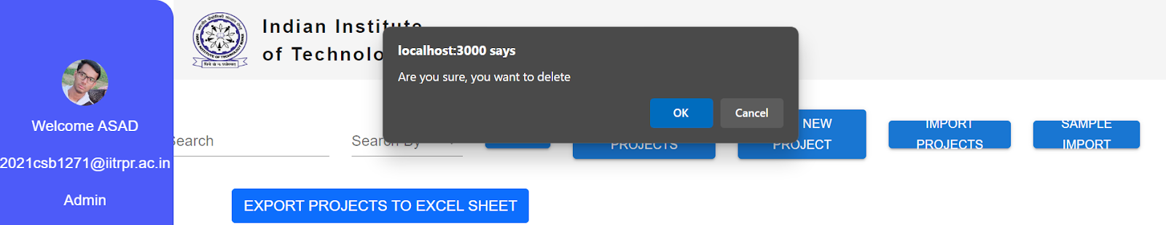
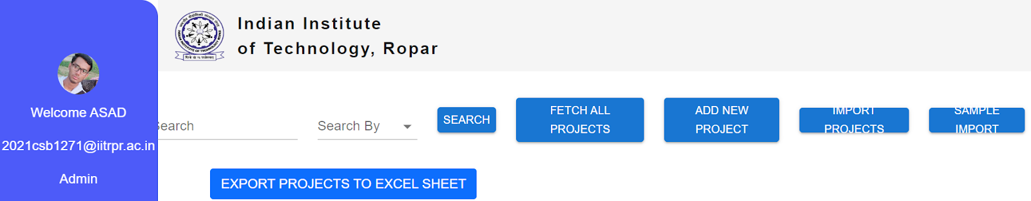
Proposed UI Changes for Web-App
Toast Integration for Error Messages
Responsive Design Implementation
Text Overflow Issue Resolution
Replacing Simple JavaScript Error() with Stylish Toast Notifications
Transitioning to Percentage-Based CSS for Responsiveness
Addressing Text Overflow in Buttons and Boxes

Slide 16
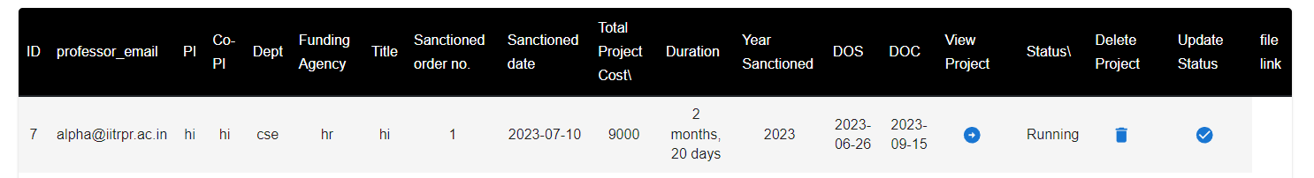
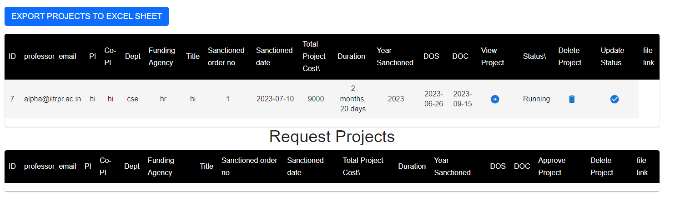
Proposed UI Changes for Web-App
Dashboard layout Adjustment
Revamped Project List Appearance
Dashboard Enhancements
Moving Left Column to Thumbnail in Navbar
Thumbnail Clickable for Expanded Info and Buttons
Redesigning Presentation of Project Lists
Introducing Headings for Projects
Improving Padding in Request Projects Table

Slide 17
Database Improvement Plan
Normalize data
Data Integrity
Identify Redundancy and Remove Anomalies
Constraints and Referential Integrity
Scalability and Standardization
Document and Maintain Schema
Enforce Validation Rules and Accommodate Future Growth
Establish Maintenance Procedures

Slide 18
Next Week
04
What we plan to do next

Slide 19
Work on UI Improvement
Here’s what we are planning to do next week:
Taking inputs from Stakeholders
Admins, Faculty and Fellows
Work Mainly on Frontend Enhancement
Features and Functions

Slide 20
Thanks!
Content by: Anisha, Anshika, Asad, Shiva
Presentation Made by: Anshika
Group: P03

